Slide 1
The Adventures of Malice in Py-Land
CST205 – Final Project

Slide 2
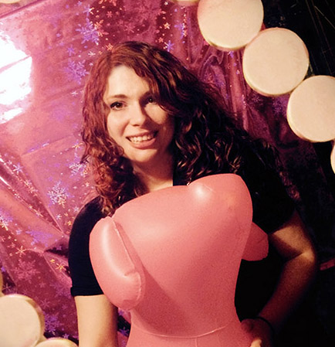
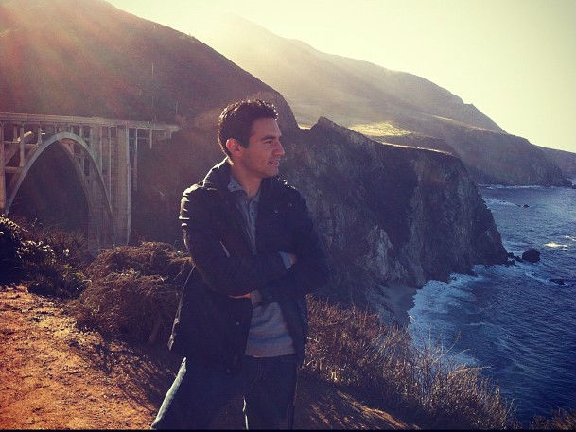
Team Members From Otter Design Inc.
Caitlin Kuleck
Luciano Avendano

Slide 3
Objective
Objective - what are you planning to accomplish for the final project?
With this project, the intent is to create a text-based game in which Malice is dropped into Py-Land.
In each area of the map, she must make a choice, and that choice determines what happens to the map.
This will be put into effect by use of picture functions, distorting what the area would have been.
An image will be attached to each ‘room’, and it will display to the screen what her choice has done.

Slide 4
Approach
We started our project by drawing a map.
The map was then color-coded and it was decided what would happen in each area.
Luciano drew up the map, while Caitlin added in the additional information.
Coding was done both individually and together, with image effect functions being put together mostly by one person and text game statements put together by the other.

Slide 5
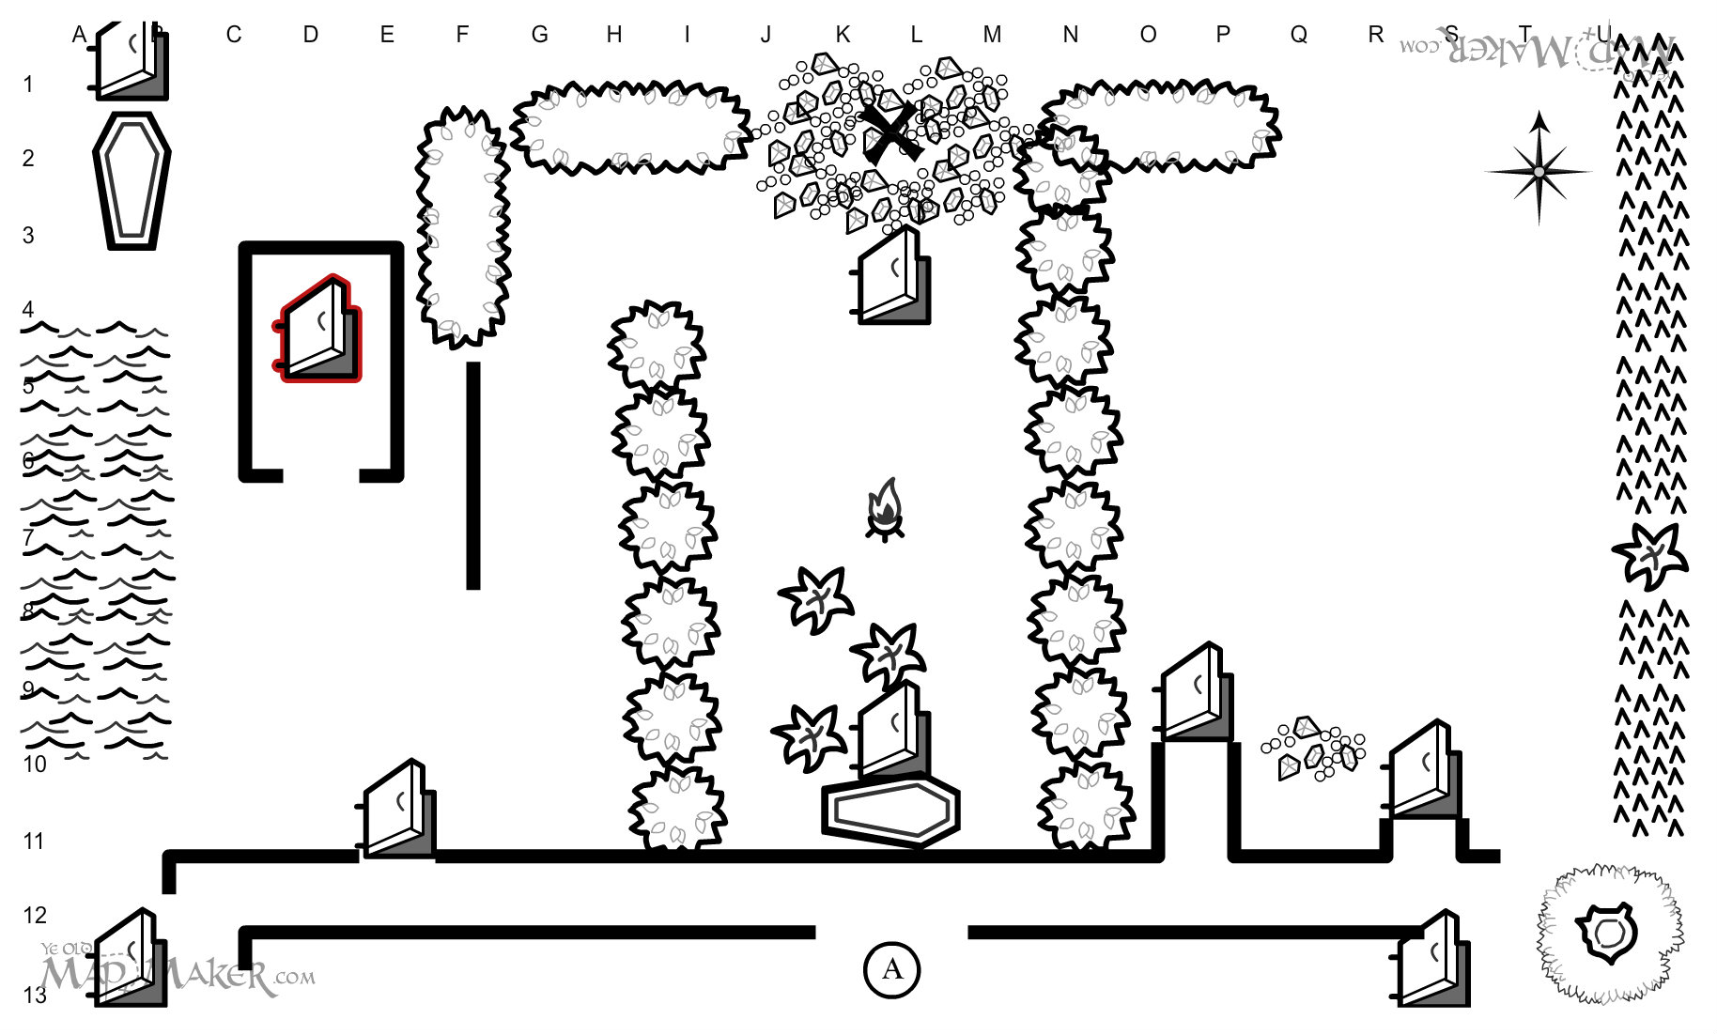
Initial Mapping

Slide 6
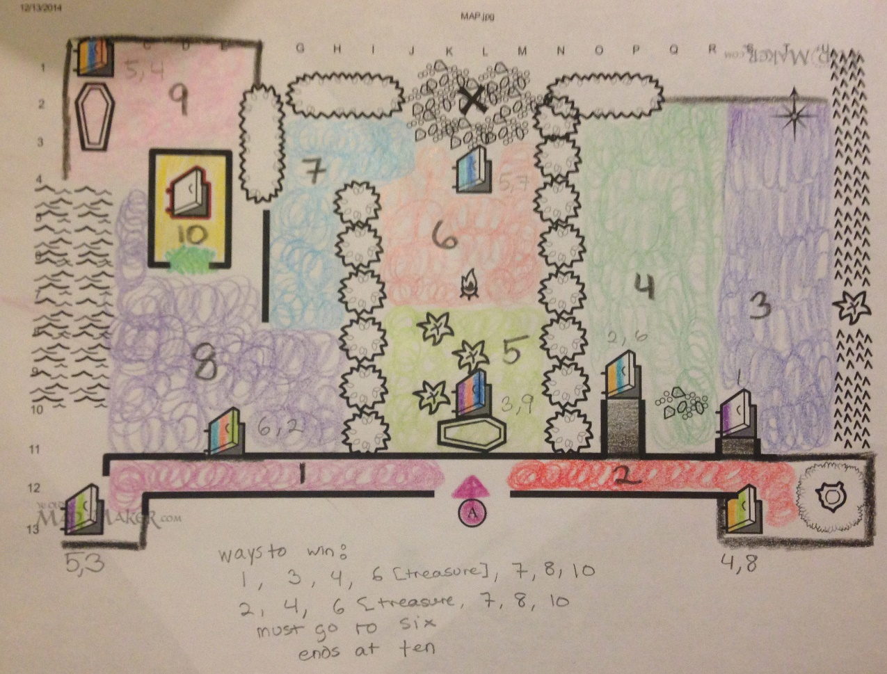
In Progress Mapping

Slide 7
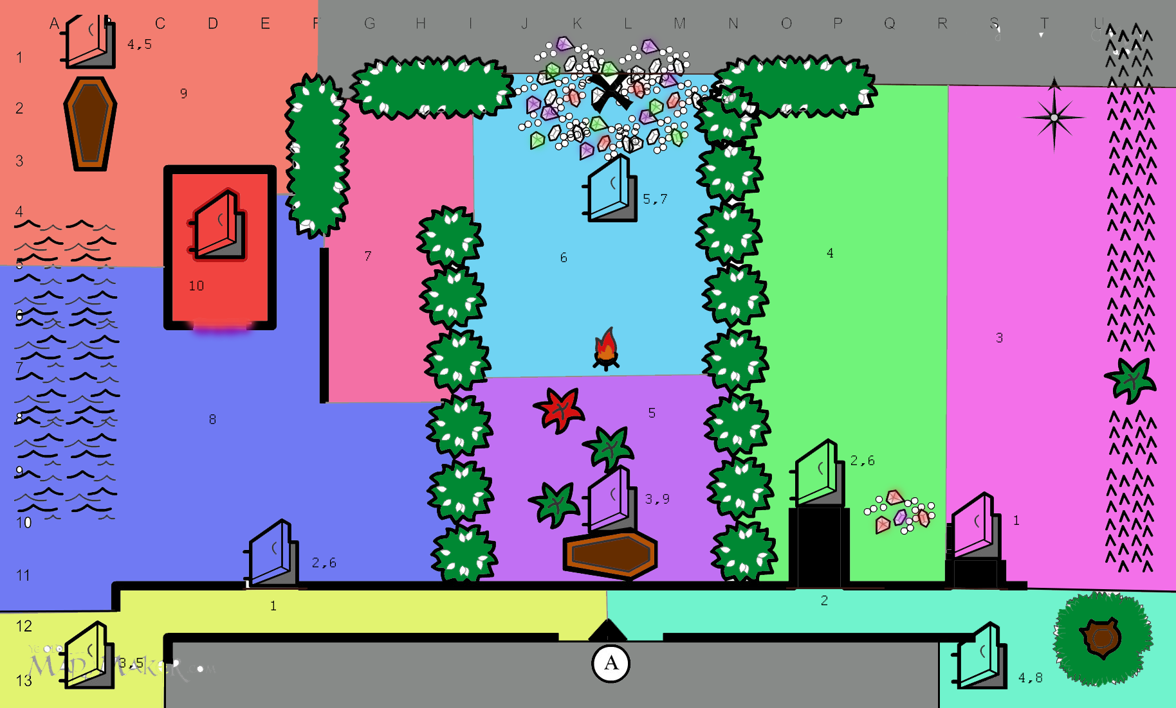
Final Mapping

Slide 8
Results
Results - what have you achieved so far? explain this for each individual team member.

Slide 9
Demonstration
Demo - can you demonstrate anything? add screenshots of your application running with descriptions

Slide 10
Top Three
I was extremely excited to learn how to use Git. It’s change how I do things.
Pair programming has been a great experience, although I actually thought it was going to be terrible.
Being able to manipulate pictures or sound without the use of Photoshop is an interesting skill I never thought I would have.
- Caitlin Kuleck
I enjoyed working in pairs, it made the learning and programming much more enjoyable.
I feel more comfortable using Python and GitHub, I plan to continue using both.
I learned new development techniques, keeping my code more agile and maintainable was a key concept in this course
- Luciano Avendano

Slide 11
Links
Group Status Document
GitHub Repository

